Slide 1





Vue Storefront Integration
custom backend integration architecture

Slide 2



Agenda
Vue Storefront integration architecture discussion:
Generic: Vue Storefront standard, generic data formats, Elastic. See tutorial
Direct: Vue Storefront for X, custom data formats, direct API calls instead of Elastic
Dedicated: custom application based on Storefront UI

Slide 3






Architecture
Vue Storefront is platform agnostic and can be connected via API to virtually any eCommerce CMS.
It doesn’t require backend changes to your current store which makes it an excellent choice for this scenario.
eCommerce CMS
Magento, Shopify or any other CMS
API Adapter
For each platform (Magento and Pimcore integrations are ready)
VUE Storefront API
Same for every platform thanks to adapter
VUE Storefront
Single Page App PWA written in Vue.js
NoSQL DB
Real-time sync based on product updates

Slide 4



Frontend Architecture
Vue Storefront Core Contains all standard eCommerce features, state management, offline capabilities and database integration. It’s upgradable as a NPM package and extendable via extensions.
Modules
(e.g new payment methods, mailchimp, integration, Google Analytics integration)
core
src
themes
modules
Your playground!
Theme For each platform (Magento and Pimcore integrations are ready)

Slide 5

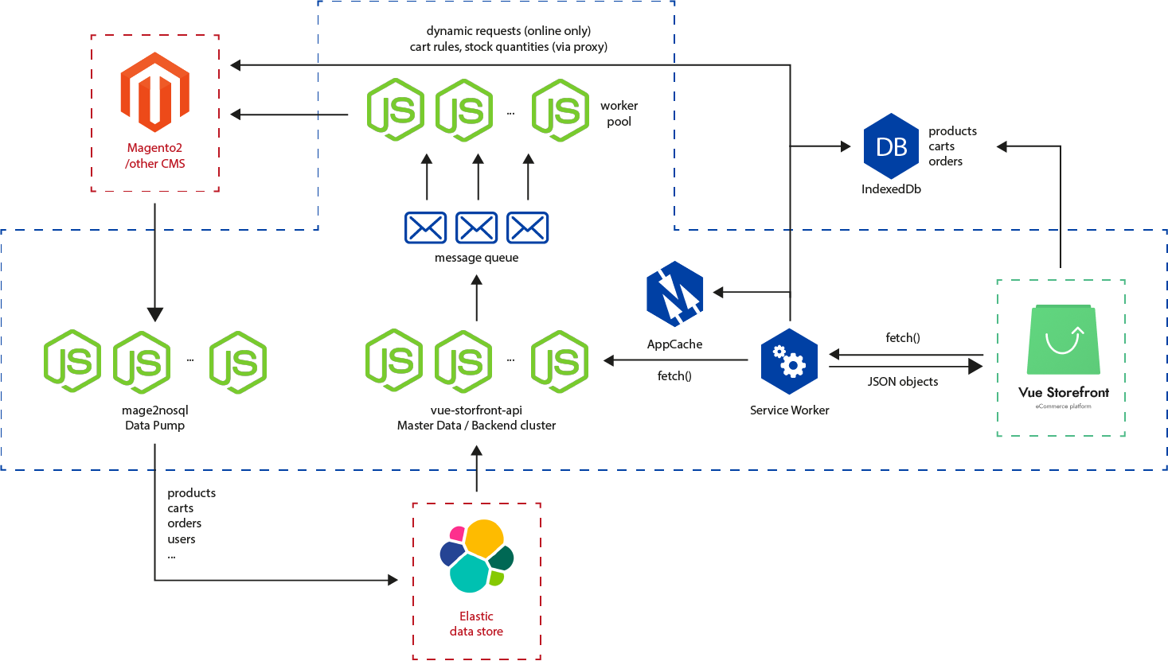
General Vue Storefront Architecture

Slide 6
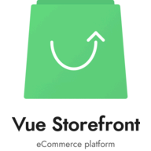


Generic: Vue Storefront connector
vue-storefront core with generic modules + default theme (data formats needs to be aligned)
vue-storefront-api
dynamic requests
Your Backend API
data indexing
VS 2.0 architecture: https://github.com/DivanteLtd/vue-storefront/issues/2696

Slide 7
Generic - Vue Storefront Connector
Pros
Cons
Visibility + OSS marketing: Vue Storefront, Community, 50 partners (agencies), trainings, docs all included,
All VS features (SSR, additional modules) - OOTB
short time to market,
generic data formats (might introduce some limitations),
architecture assumptions that might be limiting: eg. elastic search,
generic solution - so users might want to change to any other backend platform

Slide 8

Direct: Vue Storefront for X
storefront-ui, dedicated theme optimized for (data formats, features)
vue-storefront 2.0 core with dedicated modules optimized for data formats, architecture (we can skip elastic)
custom-catalog
custom-checkout
...
javascript sdk - direct calls to API
Your Backend API
VS 2.0 architecture: https://github.com/DivanteLtd/vue-storefront/issues/2696

Slide 9
Optimized: Vue Storefront for X
Pros
Cons
All the benefits of “Vue Storefront Connector”
Most of the docs + trainings + VS partners ready to work with new frontend,
Stronger Value Proposition + kind-of vendor lock-in,
We recommend publishing it as OSS to grow the community,
Optimized data flows in/out API,
Optimized data formats,
Dedicated, upgradeable theme - to leverage on UX best practices
limited compatibility with Vue Storefront (Core, but not modules)
part of the dedicated code that is not maintained by the community

Slide 10

Dedicated: Custom Frontend App
storefront-ui, dedicated theme optimized for (data formats, features) * this is optional
dedicated (node.js app or just a theme) boilerplate app + set of npm modules to let the ecommerce developers build their own sites - kind of Demandware, Hybris Spartacus approach
Storefront
javascript sdk - direct calls to API
Your Backend API
VS 2.0 architecture: https://github.com/DivanteLtd/vue-storefront/issues/2696

Slide 11
Dedicated: Storefront
Pros
Cons
Optimized/dedicated data flows in/out API,
Optimized/dedicated data formats,
Strong USP / kind-of vendor lock-in,
no community, no partners, no docs, no trainings :-),
relatively longer time to market,
no core foundation to base on
no community maintenance and improvements
no benefits from existing and future vs integrations, features and improvements

Slide 12
Framework - B: Storefront UI approach
Re-usable, extandable component library. To be used with any app / boilerplate (theme, Vue Storefront, Nuxt.js - whatever):
Details:
https://slides.com/filiprakowski/storefrontui#/
https://docs.storefrontui.io/customization.html

Slide 13







eCommerce Software House
Divante.co
pkarwatka@divante.co
501 601 055

